Slide 1

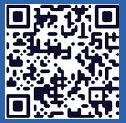
Langley Alumni Association (LAA) Board Meeting
Tuesday, May 12, 2026
2025 LAA Officers
President: Kathy Ferrare (757 880-8676)
Vice-President and Programs: Susan McClain (757 285-3778)
Secretary: Jill Marlowe (757 209-2131)
Treasurer: Ray Rhew (757 880-5817)
Communications Officer: Richard Hueschen (757 868-6453)
2025 Committee Chairs and Other Officials
Membership Committee: Amy Radford
Nominating Committee: Susan McClain
Hall of Honor Committee: Mary Beth Wusk
Website and Publication Committee: Rick Ross
IT Committee: Roman Paryz
Langley Representative: Eileen Nelson and Mariya Georgieva
Past President: Dan Palumbo
Registered Agent: Geoff Tennille
Larcalumni.org
Board Members-at-Large By Class
2027 2028 2029
Rich Antcliff Mark Ballin Mike Fremaux
Mary DiJoseph Charlie Dunton Wes Goodman
Susan McClain Odilyn Luck Jill Marlowe
Craig Ohlhorst Roman Paryz Neil O’Connor
Tony Pototzky Liliana Richwine Amy Radford
Ray Rhew Eric Rissling Ray Whipple
Geoffrey Tennille Dave Young

Slide 2
LAA Board Meeting – May 12, 2026
1:00 PM to 2:00 PM
  Call to Order & President’s Report: Kathy Ferrare
  Vice President’s Report: Susan McClain
  Secretary’s Report: Jill Marlowe
  Treasurer’s Report / Ad Hoc Committee-Donation Guidelines/Process: Ray Rhew
  Communication Report: Dick Hueschen (pass)
Committee Reports:
  Membership: Amy Radford (pass)
  Website and Newsletter: Rick Ross (pass)
  Information Technology: Roman Paryz (pass)
  Hall of Honor: Mary Beth Wusk (pass)
Old/New Business:
  Ad Hoc Committee – Retirement Protocols (NASA/LAA): Kathy Ferrare
Next Meeting: June 9, 2026 – LAA General Membership & Board Meetings
Adjourn

Slide 3
President’s Report
Work-in-progress activities
  Retirement Celebration - finalizing documentation/expenses
  Hall of Honor
Nominating Committee Chairperson – Need to find a replacement for Susan
Responsibilities:
  Annually recruit members for the committee.
  Prepare monthly General Membership and Board meetings charts.
  Annually, provide names for nominations for open Executive and Board member positions.
Ad hoc meetings/emails: As special topics/concerns arise, there may be times that meetings will be needed with the President, other Board members and NASA Liaison as needed. Review of emails to process applications and answer member questions happens throughout the month.
Affiliations: Close coordination with the Nominating Committee to identify potential officers, board members and committee chairs. Close coordination with Board members as well as LAA members.
IT knowledge/requirements: Email address; software compatible with Microsoft Word, Excel, Powerpoint; Teams (if not able to attend every meeting in person and/or for other non-monthly special meetings); and free account to Box website (document repository).
Langley Orchestra (July 16, 2026)– Need a person to coordinate volunteers
  Kathy can make the Microsoft Form asking for volunteers

Slide 4
Vice President Report – Upcoming Events
Langley Anniversary Orchestra (July 16, 2026)
They are planning to assemble a special Langley Anniversary Orchestra and are inviting interested musicians to participate.
May – Sign-Up sheet to be sent out to LAA members
NASA Langley STEM Opportunities
Action from April 14th meeting
Susan McClain meeting with Barbara Murray on May 12th.

Slide 5
Vice President Report – Upcoming Speakers
June 9, 2026 – Dr. Kevin Marlowe, Using AI to power your retirement
July 14, 2026 – LAA Picnic in the cafeteria (B2102)
August 11, 2026 - Stephanie Letourneau, Wetlands Watch, Catch the King Coordinator
September 8, 2026 – Allen Kilgore, Deputy Center Director, Update to the State of the Center
October 14, 2026 – Bryan Barmore, Master Naturalist Program

Slide 6
Vice President Report – Upcoming Speakers
  November 10, 2026 - NASA Langley’s Air Traffic Operation Laboratory presentation by Neil O’Connor (LAA Member). Tour details to follow.
  December 9, 2026 – Holiday Luncheon
  Potential Speakers:
  Generation180
  SCIFLI Update
Speaker suggestions?
Please talk to Susan McClain.

Slide 7
Secretary’s Report
April 2026 Board Meeting Minutes were approved and posted to Box
Attendance lists posted to Box
Significant Motions, Actions & Discussions from last meeting:
  DISCUSSION that LARC is not accepting STEM engagement volunteer opportunities due to lack of staff led to an ACTION for Susan to contact LARC lead to find out how LAA can support STEM volunteer opportunities.
  MOTION PASSED (Motion – Wes, 2nd – Lil) by unanimous vote to spend $400 on Class of 2025 Retirement Celebration.
PLEASE SIGN THE BOARD ATTENDANCE SHEET BEFORE YOU LEAVE!
*Committee Chair appointed by President

Slide 8
Ad Hoc Committee: Donation Guidelines/Process
Develop a process for researching and selecting opportunities to donate LAA funds that align with our mission, including the following Guidelines:
for funds needed by the LAA for non-discretionary and discretionary categories to enable determining funds available for donations
for acquiring funds other than membership dues
for determining donation fund level
May Update
Team – Rick Ross, Bill Tomek, Dave Young
Met with Melvin Ferebee – Virginia Air and Space Center
  Provided and discussed several ideas for donation opportunities
Developed summary charts on findings and recommendations

Slide 9
Ad Hoc Committee: Donation Guidelines/Process
Summary Report
Team: Dave Young, Bill Tomek, Rick Ross, Ray Rhew
Findings and Recommendations
Reviewed several organizations for potential donations (summary below).
Draft budget development process that includes donation element and criteria.
Recommended donations for 2026.
Organizations Reviewed/Discussed
Hampton Education Foundation – potential to support scholarships and or teacher grants in the $1K - $2.5K range
NASA Langley STEM Office – at this time, personnel support within the organization a higher priority than financial donations
Virginia Space Grant Consortium – potential for scholarship in the $1K to $2.5 K range
Virginia Air and Space Museum – potential funding to support educational camps/programs in the $1K - $3K range

Slide 10
Ad Hoc Committee: Donation Guidelines/Process
NASA LAA Five-Year Budget Development Process (Draft)
Treasurer
Summer – solicit expenditure inputs for the coming year(s) (provide historical data for reference purposes)
  Standard operating expenses
  LAA sponsored events
  Donation opportunities (provide target amounts)
Fall – compile responses
  Provide summary of inputs to the board for consideration/voting and or discussion
  Include donation evaluation criteria for each entry
  Include income targets to meet expenditure goals/objectives
    Recommend investment plan to meet targets (keep existing or provide new plan for review)
    Include historical revenue generation levels from dues
    Provide any other income options to meet targets
Winter – present plan to general membership including timeline for execution

Slide 11
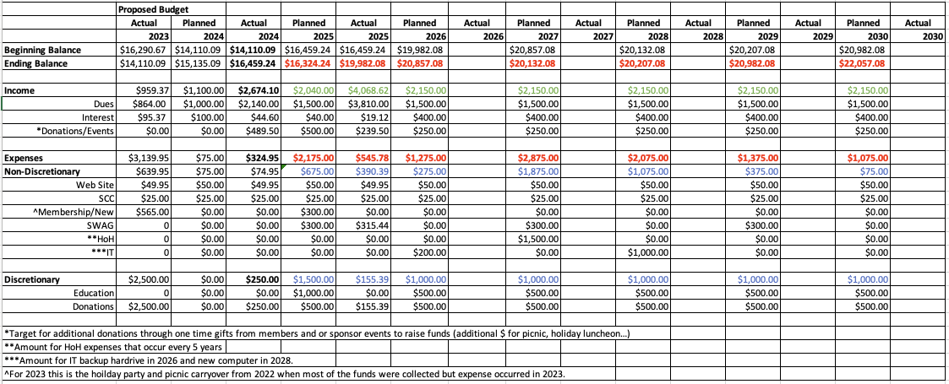
Ad Hoc Committee: Donation Guidelines/Process
Budget Example

Slide 12
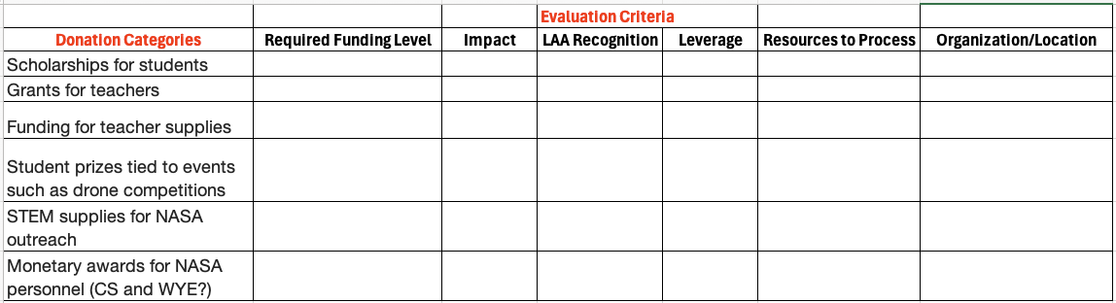
Ad Hoc Committee: Donation Guidelines/Process
Donation Evaluation Criteria

Slide 13
Old Business – Outstanding Action
  President/Treasurer to discuss forming Ad Hoc Committee for Donations: Recommend process for soliciting and evaluating donation opportunities (Ray Rhew – January 2026 Action).
Develop a process for researching and selecting opportunities to donate LAA funds that align with our mission, including the following Guidelines:
  for funds needed by the LAA for non-discretionary and discretionary categories to enable determining funds available for donations
  for acquiring funds other than membership dues
  for determining donation fund level
April Update:
  Team – Rick Ross, Bill Tomek, Dave Young
  Met with Bonnie Murray – NASA LaRC OSTEM
    Provided and discussed several ideas for volunteering as well as donation opportunities
  Plan to develop consolidated list to review at next team meeting – April
May Update
  Met with Melvin Ferebee – Virginia Air and Space Center
    Provided and discussed several ideas for donation opportunities
  Developed summary charts on findings and recommendations

Slide 14
Old Business - Retirement Protocols (NASA/LAA) – Next Steps?
Outstanding Action from LAA Board Meeting: Retirement Protocol Question (Rich Antcliff) – What is the protocol policy that NASA follows for retirements (album, certificates, party)? Should the LAA have one?
April 2026 Update: Retirement Celebration – May 1st @ 3:00 pm
  75+ RSVP’s received inviting 90 guests / estimating for 300 personnel
  Completed and in graphics/printing: Celebration program, certificates, retiree gift
  Announcement to Center personnel placed on Inside Langley. Flyer/Names also sent to Langley organizations.
  Announcement sent to LAA members, request for one-day badges for LAA members (not retirees/guests to be celebrated), and request for volunteers
    RSVP for a one-day badge and/or plan on volunteering due Fri, April 17
    Need ~30 volunteers
  Motion/Vote Passed - Estimated Cost: $400
    LAA bringing in the food/paper products.
    Food: Cake, Water, Candy & Mints; Paper Products (unused can be used for the picnic)
May 1st Retirement Celebration was a HUGE Success!
  Received several Thank You notes from the retirees. Enjoyed by all.
  Thank you so much to everyone that participated in making this event so wonderful!
  Approved Budget: $400 / Initial Expenses: $370 (waiting on one more expense)

Slide 15
Old Business – NASA Langley STEM Opportunities
April 14 Board Meeting: Discussion that LaRC is not accepting STEM engagement volunteer opportunities due to lack of staff led to an ACTION for Susan McClain to contact LARC lead to find out how LAA can support STEM volunteer opportunities.
May Update: Susan reached out to Barbara Murray. Will meet with her on May 12th.

Slide 16
Old Business – Outstanding Actions
Further investigate the hybrid approach and investing with Vanguard and report back to the board. Unanimously approved by all present and on-line. (Ray Rhew – Jan 2026 Action)
  Initial contact made with Vanguard (preliminary options discussed)
  More details on AIAA investment approach provided (summary below)
    Established an Investment Portfolio
      maintain a minimum of 50% of its assets in high quality fixed income securities (includes investment grade corporate bonds, U.S. Treasury and government agency bonds, and mortgage-backed securities) and a minimum of 25% of its assets in common stocks of companies with expectations of above average growth and/or sustainable dividend payout.
      shall be realized through investment in high quality mutual fund(s) as opposed to a stock portfolio. The selected investment portfolio shall have an expense ratio less than 1% (less than 0.5% if possible).
      Eighty percent (80%) of all dividend and capital gain distributions for the fiscal year (Oct. 1-Sept. 30) preceding a scholarship award shall be applied toward a “Futures in Aerospace” scholarship(s).
      Twenty percent (20%) of all dividend and capital gain distributions each fiscal year shall be reinvested
Feb 2026 Update: Plan to continue discussions on Vanguard account opening and access procedures. Will hold action request until Ad Hoc committee objectives are completed.

Slide 17
New Business - May 12, 2026
Langley Alumni Association 40th Anniversary – February 2027
  Other NASA Alumni organizations have used their anniversaries to raise funds for donations/scholarships by selling their alumni merchandise (shirts, t-shirts, hats etc).
  Interest in organizing this type of fundraiser

Slide 18
New Business

Slide 19
Back-UP / Additional Info on Actions

Slide 20
Old Business – Outstanding Action – Prior Month Info
  President/Treasurer to discuss forming Ad Hoc Committee for Donations: Recommend process for soliciting and evaluating donation opportunities (Ray Rhew – January 2026 Action).
  Motivation – LAA Bylaws Purpose:
  Assist the LaRC to maintain contact with Alumni to the mutual benefit of the LaRC and the Alumni.
  Encourage and facilitate Alumni involvement in activities benefiting students from elementary school through college to increase the students’ ability to succeed in all educational opportunities.
Develop a process for researching and selecting opportunities to donate LAA funds that align with our mission, including the following Guidelines:
  for funds needed by the LAA for non-discretionary and discretionary categories to enable determining funds available for donations
  for acquiring funds other than membership dues
  for determining donation fund level
Feb 2026, Update: Ad Hoc Committee established in January; Ray Rhew – Committee Chair. Requested volunteers at Feb General Membership Meeting
March 2026 Update – Committee members met to discuss options
April Update:
  Team – Rick Ross, Bill Tomek, Dave Young
  Met with Bonnie Murray – NASA LaRC OSTEM
    Provided and discussed several ideas for volunteering as well as donation opportunities
  Plan to develop consolidated list to review at next team meeting in April

Slide 21
Old Business – Outstanding Actions – Prior Month Info
Retirement Protocol Question (Rich Antcliff) – What is the protocol policy that NASA follows for retirements (album, certificates, party)? Should the LAA have one?
  Nov 2024 & April 2025 Updates: Contacted NASA Langley Human Capital Ofc – The employee’s organization decides.
Jan 13, 2026: Action for President to determine approach for DRP Retirement Party: Possibly ad-hoc committee or Program Committee to lead.
Feb 2026 Update: Ad Hoc Committee, Retirement Protocols (NASA/LAA), was established.
  Rich Antcliff is the Committee Chair. Expanding scope to include short/long term activities. Committee Members: Rich Antcliff, Jill Marlowe, Sharon Monica Jones, and Christina Moats-Xavier
March 2026 Update: Retirement Celebration – May 1st @ 3:00 pm Reid
  Finalized initial plans with Steve Gayle (Office of the Director).
  Invite will go to employees who retired January 1, 2025 – January 31, 2026.
    Celebration Activities- Employee recognition, Class of 2025 photo, & light refreshments
  LAA members and Center employees will also be invited.

