Slide 1

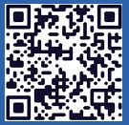
Langley Alumni Association (LAA) General Membership Meeting
Tuesday, April 14, 2026
2025 LAA Officers
President: Kathy Ferrare (757 880-8676)
Vice-President and Programs: Susan McClain (757 285-3778)
Secretary: Jill Marlowe (757 209-2131)
Treasurer: Ray Rhew (757 880-5817)
Communications Officer: Richard Hueschen (757 868-6453)
2025 Committee Chairs and Other Officials
Membership Committee: Amy Radford
Nominating Committee: Susan McClain
Hall of Honor Committee: Mary Beth Wusk
Website and Newsletter Committee: Rick Ross
IT Committee: Roman Paryz
Langley Representative: Eileen Nelson and Mariya Georgieva
Past President: Dan Palumbo
Registered Agent: Geoff Tennille
Larcalumni.org
Board Members-at-Large By Class
2027 2028 2029
Rich Antcliff Mark Ballin Mike Fremaux
Mary DiJoseph Charlie Dunton Wes Goodman
Susan McClain Odilyn Luck Jill Marlowe
Craig Ohlhorst Roman Paryz Neil O’Connor
Tony Pototzky Liliana Richwine Amy Radford
Ray Rhew Eric Rissling Ray Whipple
Geoffrey Tennille Dave Young

Slide 2
LAA General Membership Meeting – April 14, 2026
11:30 PM to 1:00 PM
  Welcome & President’s Report: Kathy Ferrare
  Secretary’s Report: Jill Marlowe
  Treasurer’s Report / Ad Hoc Committee – Donation Guidelines/Process: Ray Rhew
  Communication Report: Dick Hueschen
Committee Reports:
  Membership: Amy Radford
  Website and Newsletter: Rick Ross
  Information Technology: Roman Paryz (pass)
  Hall of Honor: Mary Beth Wusk
  Ad Hoc Committee – Retirement Protocols (NASA/LAA): Rich Antcliff
Vice President’s Report: Susan McClain
Speaker: Rick Ross (LAA Member) - Charlatans, Swindlers and Bilks
Next Meeting: May 12, 2026 – Quesst Project Update: X-59 Soars: A New Era in Supersonic Flight Begins presentation by Lori Ozoroski, NASA Langley
Adjourn: Board Meeting next – All LAA members are welcome!

Slide 3
President’s Report
LAA Health: Growth in Membership this month +5; Treasury is $23k
March 10, 2026, Board Meeting Discussions:
  Exploring more targeted use of LAA social media to amplify LARC impact; Jill Marlowe, Rick Ross, and Amy Radford are discussing ways to strategically use LAA socials to amplify LARC contributions & spawn opportunities.
    If you are interested in helping write social media content, please contact Rick Ross (Website & Publication Committee Chair)
  Potential volunteer opportunities that Center Director Dyal raised for LAA members; investigate LAA support OD is requesting for Viking 50th Event, FDRF ribbon cutting and cohort program
    Discussed support with several Office of the Director employees. As requests come into the LAA, Susan McClain (Program Committee Chair) will request volunteer support.
Class of 2025 Retirement Celebration / Many Volunteers are Needed
  May 1st @ 3:00 pm in the Reid Center
Hall of Honor – Productive start-up meeting with Dr. Trina Dyal

Slide 4
Secretary’s Report
March 2026 General Meeting minutes approved & posted to Box
  Attendance: 67 in person, 21 remote
  No significant motions / actions / discussions
March 2026 Board Meeting Minutes approved & posted to Box
PLEASE SIGN THE ATTENDANCE SHEET BEFORE YOU LEAVE!

Slide 5
Treasurer Summary for March 2026
March 2026 Summary
  Organization Share $25.00
  Money Market Savings $3,959.92
  Smart Checking $3,718.86
  Certificate of Deposit $15,037.40
  Total $22,741.18
  Increase (from February): $207.63
    Income:
      Interest
      Dues (7 yearly, 1 lifetime)
    Expenses
      None in January
  Set-up 12-month Certificate of Deposit at LFCU
  Yvonne completed the 2025 audit – initial meeting to be held to discuss findings/recommendations

Slide 6
Ad Hoc Committee: Donation Guidelines/Process
Develop a process for researching and selecting opportunities to donate LAA funds that align with our mission, including the following Guidelines:
for funds needed by the LAA for non-discretionary and discretionary categories to enable determining funds available for donations
for acquiring funds other than membership dues
for determining donation fund level
April 2026 Update
Team – Rick Ross, Bill Tomek, Dave Young
Met with Bonnie Murray – NASA LaRC OSTEM
  Provided and discussed several ideas for volunteering as well as donation opportunities
Plan to develop consolidated list to review at next team meeting - April

Slide 7
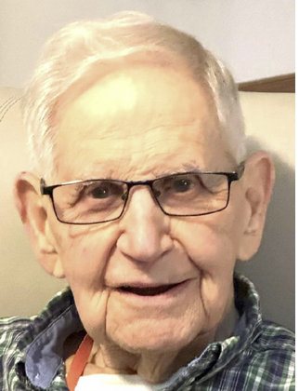
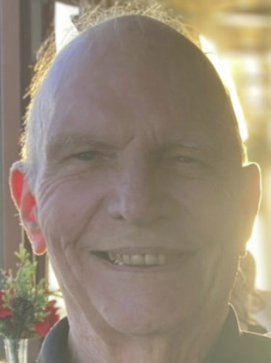
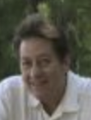
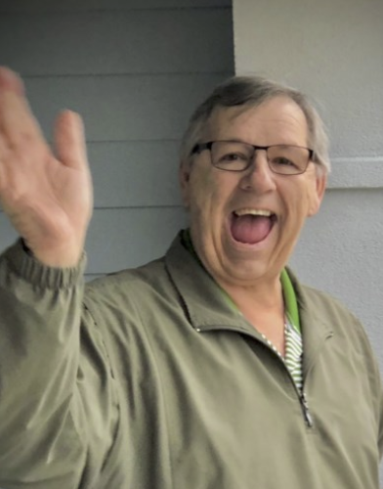
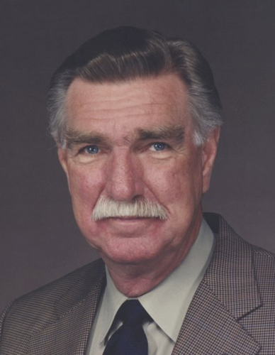
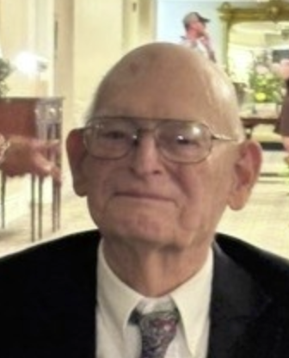
In Memory Of Individuals April 14, 2026
John Whitmore, 98
Jerry South, 90
Dr. Eric “Ziggy” Saether, 69
James Pike, 70
Uriel Lovelace, 91
James Manning, 97

Slide 8
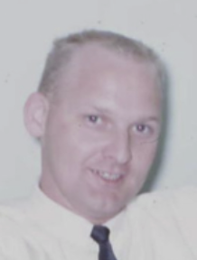
In Memory Of Individuals April 14, 2026 (continued)
James Monteith, 92

Slide 9
Membership Report
5 New members:
Mike Cisewski retired from the Space Technology and Exploration Directorate in 2022 with 32 years service. Mike resides in Yorktown with his spouse Amy.
Karen Smith retired from Safety and Mission Assurance Directorate in 2025 with 33 ½ years service. Karen resides in North Carolina with her spouse Paul.
Sheila Watford retired from the Office of Procurement in 2025 with 7 years service. Sheila resides in Carrollton with her spouse Milton.
Kenneth (Ken) Goetzke retired from the Office of General Counsel in 2025 with 25 years service. Ken resides in North Carolina with his spouse Lynne.
Gregory Slover retired from the Research Support Directorate with 15 years service. Gregory resides in Poquoson with his spouse DeeAnn.

Slide 10
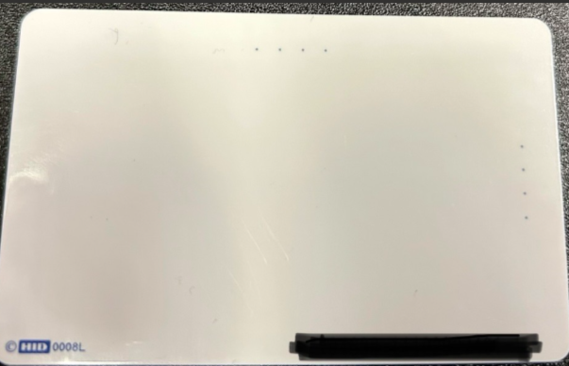

Membership Report
Currently, we have 290 Active Members
Reminder: Effective April 6, members must scan their Activity Badge at the front gate
  If you have affiliations with other Langley activities, contact the associated POC to gain applicable access
    LEA Clubs & Athletics « Langley Exchange
  Some replacement badges were printed on the wrong type of card
    On the back there should be a HID blue copyright lettering, a set of numbers and 4 gray dots on the side
Be sure to sign the attendance sheet!

Slide 11
Membership Report
Membership Committee Initiative Updates
  New LAA Welcome Video
    Created a draft script and charts
      Next step – Make friends with media folks
  Application Process
    Met with Data Analytics Analyst on March 10 and meeting again April 14
    Developed draft LAA application form
      Next step – Test form and collect feedback
  Anyone interested in helping, please let me know at Membership@larcalumni.org

Slide 12
Website & Publications
Prepared a booklet for the Class of 2025 Retirement Celebration
Updated the website with recent information & events
March 2026 newsletter is now available
LAA Facebook page continues to grow
Thanks to those who submitted newsletter articles!

Slide 13
Hall of Honor
Met with Trina Dyal (Acting Center Director) (April 8th)
Kick-off meeting with LAA Operations Committee (April 14th)
More details to follow at May General Membership Meeting
Hall of Honor ceremony to occur during Langley’s 110th Year Celebration (Tentative: July 2027)

Slide 14
Ad Hoc Committee: Retirement Protocols (NASA/LAA)
Outstanding Action from LAA Board Meeting: Retirement Protocol Question (Rich Antcliff) – What is the protocol policy that NASA follows for retirements (album, certificates, party)? Should the LAA have one?
March 2026 Update: Retirement Celebration – May 1st @ 3:00 pm Reid Center
  Finalized initial plans with Steve Gayle (Office of the Director).
  Invite will go to employees who retired January 1, 2025 – January 31, 2026.
    Celebration Activities: Employee recognition, Class of 2025 photo, & light refreshments
  LAA members and Center employees will also be invited.
April 2026 Update: Retirement Celebration – May 1st @ 3:00 pm
  75 RSVP’s received inviting 90 guests / Estimated attendance 300 people
  Completed and in graphics/printing: Celebration program, certificates, retiree gift
  Announcement to Center personnel placed on Inside Langley. Flyer also to be sent to Langley organizations.
  Announcement to LAA members, request for one-day badges for LAA members (not retirees/guests to be celebrated), and request for volunteers
    RSVP for a one-day badge and/or plan on volunteering due Sat, 4/19

Slide 15
Vice President Report – Membership Involvement
Langley Anniversary Orchestra
As part of NASA Langley’s celebration of the 250th Anniversary, they want to showcase the incredible musical talent within our center.
They are planning to assemble a special Langley Anniversary Orchestra and are inviting interested musicians to participate.
Dates: In late July or early August, they anticipate holding:
  One afternoon rehearsal
  A dress rehearsal the day of the concert
  A late afternoon or evening concert
The LAA will be sending out a request in April for members to sign up. If you’d like to help organize this, please see Susan.

Slide 16
Vice President Report – Upcoming Events
Class of 2025 Retirement Celebration
  May 1st @ 3:00 pm in the Reid Center
  Sent to LAA Members: Announcement to LAA members, request for one-day badges for LAA members (not retirees/guests to be celebrated), and request for volunteers
  RSVP for a one-day badge and/or
  plan to volunteer due Friday, 4/17
  Contact Lil Richwine if you have any questions.

Slide 17
Vice President Report – Upcoming Speakers
April 14, 2026 – Rick Ross (LAA Member): Charlatans, Swindlers and Bilks
May 12, 2026 –Quesst Project Update: X-59 Soars: A New Era in Supersonic Flight Begins presentation by Lori Ozoroski, NASA Langley
June 9, 2026 – Tentative – Generation180. Generation180 is a national nonprofit working to inspire and equip people to take action on clean energy in their homes and communities.
July 14, 2026 – LAA Picnic
August 11, 2026 – Stephanie Letourneau, Wetlands Watch

Slide 18
Vice President Report – Upcoming Speakers
September 8, 2026 – Allen Kilgore, Deputy Center Director, Update to the State of the Center
October 14, 2026 – Bryan Barmore, Master Naturalist Program
November 10, 2026 – Neil O’Connor, NASA Langley’s Air Traffic Operations Laboratory
December 9, 2026 – Holiday Luncheon
Potential Speakers –
Dr. Kevin Marlowe – Large Language Models

Slide 19
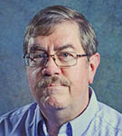
Today’s Speaker
Rick Ross
Charlatans, Swindlers and Bilks

