Slide 1

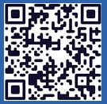
Langley Alumni Association (LAA) General Membership Meeting
Tuesday, March 10, 2026
2025 LAA Officers
President: Kathy Ferrare (757 880-8676)
Vice-President and Programs: Susan McClain (757 285-3778)
Secretary: Jill Marlowe (757 209-2131)
Treasurer: Ray Rhew (757 880-5817)
Communications Officer: Richard Hueschen (757 868-6453)
2025 Committee Chairs and Other Officials
Membership Committee: Amy Radford
Nominating Committee: Susan McClain
Hall of Honor Committee: Mary Beth Wusk
Website and Newsletter Committee: Rick Ross
IT Committee: Roman Paryz
Langley Representative: Eileen Nelson and Mariya Georgieva
Past President: Dan Palumbo
Registered Agent: Geoff Tennille
Larcalumni.org
Board Members-at-Large By Class
2027 2028 2029
Rich Antcliff Mark Ballin Mike Fremaux
Mary DiJoseph Charlie Dunton Wes Goodman
Susan McClain Odilyn Luck Jill Marlowe
Craig Ohlhorst Roman Paryz Neil O’Connor
Tony Pototzky Liliana Richwine Amy Radford
Ray Rhew Eric Rissling Ray Whipple
Geoffrey Tennille Dave Young

Slide 2
LAA General Membership Meeting – March 10, 2026
11:30 PM to 1:00 PM - Update
Welcome & President’s Report: Kathy Ferrare
Secretary’s Report: Jill Marlowe
Treasurer’s Report / Ad Hoc Committee – Donation Guidelines/Process: Ray Rhew
Communication Report: Dick Hueschen
Committee Reports:
Membership: Amy Radford
Website and Newsletter: Rick Ross
Information Technology: Roman Paryz (pass)
Hall of Honor: Mary Beth Wusk
Ad Hoc Committee – Retirement Protocols (NASA/LAA): Rich Antcliff
Vice President’s Report: Susan McClain
Speaker: Dr. Trina Dyal, Acting Center Director, NASA Langley Research Center
Next Meeting: April 14, 2026 – Rick Ross, “Charlatans, Swindlers, and Bilks”
Adjourn: Board Meeting next – All LAA members are welcome!

Slide 3
President’s Report - Redo
Productive Transition is continuing.
Hall of Honor activity started with several introductory meetings in Feb/March.
LAA Health: Growth in Membership this month +3; Treasury is $23k
February 10, 2026, Board Meeting
MOTION PASSED to invest $15K in 13-month Certificate of Deposit at LFCU since high yield savings account is not an option for businesses (passage of this motion closed ACTION on near-term investment decision).
DISCUSSION on overworking the investment strategy, given the relatively low amount of capital in question? To be addressed by ad-hoc committee Donation Guidelines/Process (Ray Rhew, Chairperson).
March 2026 Newsletter – Thank you to LAA members who contributed articles!
LAA activity badges are being converted to scannable badges.
Please go to the Badge and Pass Office prior to 4/6/26 to get your new badge.
If you do not go by 4/6/26, you will be directed to the BPO from the gate officials.
More information will be provided to LAA badged members from Amy Radford.
PLEASE DO NOT WAIT UNTIL 4/6/26 TO GO TO BPO.

Slide 4
Secretary’s Report
February 2026 General Meeting minutes approved & posted to Box
Attendance: 57 in person, 11 remote
No significant motions / actions / discussions
February 2026 Board Meeting Minutes approved & posted to Box
PLEASE SIGN THE ATTENDANCE SHEET BEFORE YOU LEAVE!

Slide 5
Treasurer Summary for Februuary 2026
February 2026 Summary
Organization Share $25.00
Money Market Savings $18,959.69
Smart Checking $3,548.86
Total $22,533.55
Increase (from December): $80.72
Income:
Interest
Dues (8 yearly)
Expenses
None in January
$15K deposited in LFCU CD: 12 months at 3.3%
Investigated other CD and MM options – similar terms
Long term – develop investment strategy that aligns with LAA financial goals

Slide 6
Ad Hoc Committee: Donation Guidelines/Process
Develop a process for researching and selecting opportunities to donate LAA funds that align with our mission, including the following Guidelines:
for funds needed by the LAA for non-discretionary and discretionary categories to enable determining funds available for donations
for acquiring funds other than membership dues
for determining donation fund level
March Update:
Team – Rick Ross, Bill Tomek, and Dave Young
Initial Meeting:
Discussed other organizations approaches/activities – AIAA Hampton Roads Section, Virginia Space Grant Consortium, Hampton Education Foundation, LaRC
Discussed donation funding approaches in context of our financial status and outlook – importance of setting donation goals to help guide process and decisions
Next meeting – week of March 9th or 16th

Slide 7
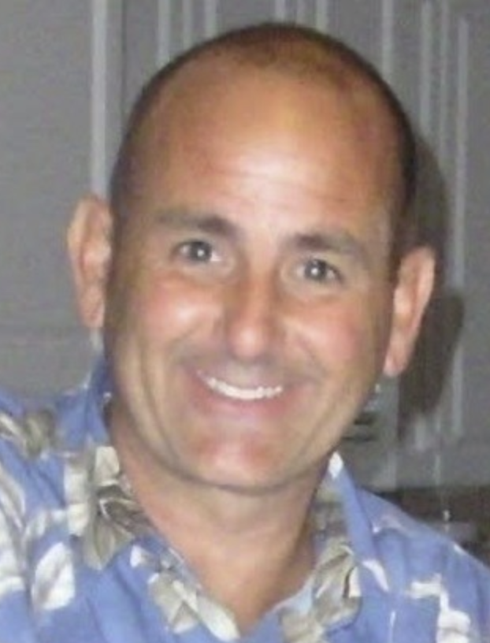
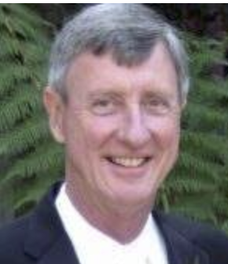
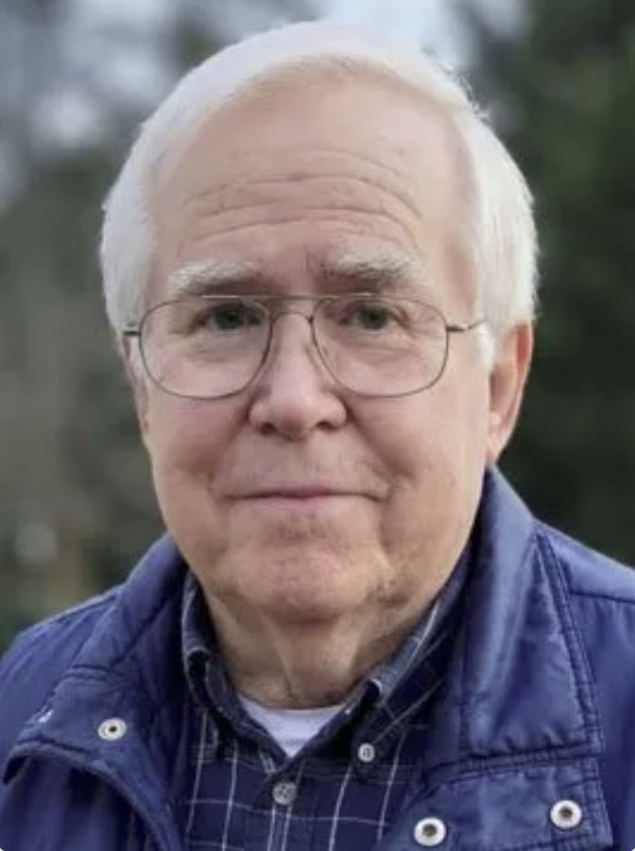
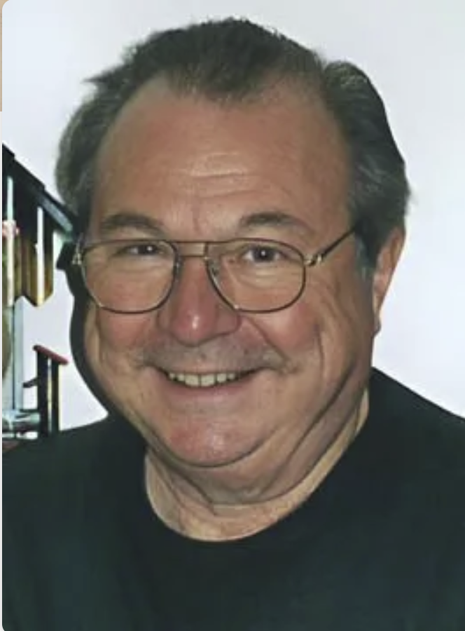
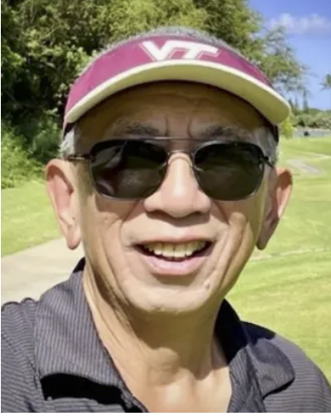
In Memory Of Individuals March 10, 2026
James Fenbert, 66
Wallace “Wally” Sawyer, 82
Glenn Taylor, 85
Dr. Frank Allario, 85
Long Yip, 76

Slide 8
Membership Report
Three New members:
Vincent Schultz who retired from the Aeronautics Research Directorate in 2026 with 35 years service. Vincent resides in Williamsburg with his spouse Deborah.
Russ Rausch who retired from the Aeroelasticity Branch in 2026 with 25 years service. Russ resides in Yorktown with his spouse Elizabeth.
Mark Saunders who retired from NASA Independent Program Assessment Office in 2008 with 19 years service. Mark resides in South Carolina with his spouse Beth.
Be sure to sign the attendance sheet!

Slide 9

Membership Report
As of March 1, we have 286 Active Members
35 members classified as Past Members at the end of February
Reminders were sent out in December 2025
Emails were sent in February 2026 to members who haven’t paid dues for a year or more about their status change
Routine emails and invitations to special events have stopped
If your phone number, address or email address have changed, please send updates to Membership@larcalumni.org
Be sure to sign the attendance sheet!

Slide 10
Membership Report
Membership Committee Initiative Updates
New LAA video
Researching different types of software
Drafting script
Badging Process
Met with Mariya – what’s working/what’s not
Application Process
Meeting with Data Analytics analyst March 10
Send your thoughts/suggestions for improvements to Membership@larcalumni.org
Be sure to sign the attendance sheet!

Slide 11
Website & Publications
Updated the website with recent information & events
March 2026 newsletter is now available
LAA Facebook page continues to grow
Thanks to those who submitted newsletter articles!

Slide 12
Hall of Honor Committee Report
Hall of Honor Committee
Mary Beth Wusk, Chair
Jeff Antol
Steve Bauer
Wes Goodman
Susan McClain
Neil O’Connor
Initiated HoH Process Discussions
Feb 12: Background: Kathy Ferrare/MB Wusk
Feb 26: Lessons Learned meeting: Michelle Ferebee/Bo Walkley/Kathy Ferrare/MB Wusk
Mar 5: Ops team Lessons Learned meeting: Michelle Ferebee/Bo Walkley/Kathy Ferrare/MB Wusk
Meet with Center Leadership (March)
Kick-off meeting with HoH Operations Committee (March/April)
Brief LAA with plans forward (April 14th)
Summer: On-line nomination system active

Slide 13
Ad Hoc Committee: Retirement Protocols (NASA/LAA)
Outstanding Action from LAA Board Meeting: Retirement Protocol Question (Rich Antcliff) – What is the protocol policy that NASA follows for retirements (album, certificates, party)? Should the LAA have one?
Nov 2024 & April 2025 Updates: Contacted NASA Langley Human Capital Ofc – The employee’s organization decides.
Jan 13, 2026: Action for President to determine approach for DRP Retirement Party: Possibly ad hoc committee or Program Committee to lead.
Feb 2026 Update: Ad Hoc Committee, Retirement Protocols (NASA/LAA), was established.
Rich Antcliff is the Committee Chair. Expanding scope to include short and long term activities.
Committee Members: Rich Antcliff, Jill Marlowe, Sharon Monica Jones, and Christina Moats-Xavier
March 2026 Update: Retirement Celebration – May 1st @ 3:00 pm Reid Center
Finalized initial plans with Steve Gayle (Office of the Director).
Invite will go to employees who retired January 1, 2025 – January 31, 2026.
Celebration Activities: Employee recognition, Class of 2025 photo, & light refreshments
LAA members and Center employees will also be invited.

Slide 14
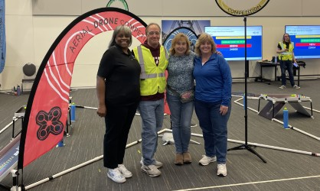
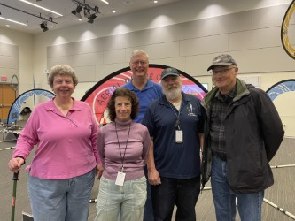
Vice President Report – Membership Involvement
February 21, 2026: Aerial Drone Competition
Thanks so much to everyone who volunteered at the Aerial Drone Competition on February 21, 2026. Sharon Monica Jones, Louis Glaab, Lil Richwine, Kathy Ferrare, Linda Bangert, Mary DiJoseph, Dave Hinton, Lawrence Taylor, John Berry, and Christina Moats-Xavier volunteered a total of 58 hours that day and worked the check-in desk, served as a referee, pit administration, lunch assistance, inspection table support, and team queueing.

Slide 15



Vice President Report – Membership Involvement
Langley Anniversary Orchestra
As part of NASA Langley’s celebration of the 250th Anniversary, they want to showcase the incredible musical talent within our center.
They are planning to assemble a special Langley Anniversary Orchestra and are inviting interested musicians to participate.
Dates: In late July or early August, they anticipate holding:
One afternoon rehearsal
A dress rehearsal the day of the concert
A late afternoon or evening concert
The LAA will be sending out a request soon for members to sign up.

Slide 16
Vice President Report – Upcoming Events
March 10, 2026:
The State of the Center –presentation by Dr. Trina Dyal, Acting Center Director, NASA Langley
Upcoming Speakers:
April 14, 2026 -- Rick Ross (LAA Member): Charlatans, Swindlers and Bilks
May 12, 2026 -- Quesst Project Update: X-59 Soars: A New Era in Supersonic Flight Begins presentation by Lori Ozoroski, NASA Langley
June 9, 2026 -- NASA Langley’s Air Traffic Operation Laboratory presentation by Neil O’Connor (LAA Member) - Tour details to follow.
July 14, 2026 -- LAA Picnic – Details to follow!
Interested in volunteering to organize a Tour or Event this Fall?
Please contact Susan McClain.

Slide 17
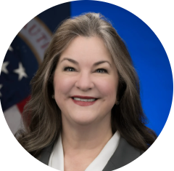
Today’s Speaker
Dr. Trina Dyal
Acting Center Director
NASA Langley Research Center

