Slide 1

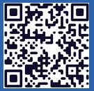
Langley Alumni Association (LAA) Board Meeting
Tuesday, March 10, 2026
2025 LAA Officers
President: Kathy Ferrare (757 880-8676)
Vice-President and Programs: Susan McClain (757 285-3778)
Secretary: Jill Marlowe (757 209-2131)
Treasurer: Ray Rhew (757 880-5817)
Communications Officer: Richard Hueschen (757 868-6453)
2025 Committee Chairs and Other Officials
Membership Committee: Amy Radford
Nominating Committee: Susan McClain
Hall of Honor Committee: Mary Beth Wusk
Website and Publication Committee: Rick Ross
IT Committee: Roman Paryz
Langley Representative: Eileen Nelson and Mariya Georgieva
Past President: Dan Palumbo
Registered Agent: Geoff Tennille
Larcalumni.org
Board Members-at-Large By Class
2027 2028 2029
Rich Antcliff Mark Ballin Mike Fremaux
Mary DiJoseph Charlie Dunton Wes Goodman
Susan McClain Odilyn Luck Jill Marlowe
Craig Ohlhorst Roman Paryz Neil O’Connor
Tony Pototzky Liliana Richwine Amy Radford
Ray Rhew Eric Rissling Ray Whipple
Geoffrey Tennille Dave Young

Slide 2
LAA Board Meeting – March 10, 2026
1:00 PM to 2:00 PM
  Call to Order & President’s Report: Kathy Ferrare
  Vice President’s Report: Susan McClain
  Secretary’s Report: Jill Marlowe
  Treasurer’s Report / Ad Hoc Committee-Donation Guidelines/Process: Ray Rhew (pass)
  Communication Report: Dick Hueschen (pass)
Committee Reports:
  Membership: Amy Radford
  Website and Publications: Rick Ross
  Information Technology: Roman Paryz
Old/New Business: Kathy Ferrare
  Ad Hoc Committee – Retirement Protocols (NASA/LAA): Rich Antcliff
Next Meeting: April 14, 2026 – LAA General Membership & Board Meetings
Adjourn

Slide 3
President’s Report
Work-in-progress activities
  Productive transition is continuing!
  March 2026 Newsletter – Thank You Board Members for providing information!
  Retirement Celebration: May 1st @ 3:00 pm in the Reid Center
    In the April timeframe, an email will go out to LAA members about this event and asking for information if you need a one-day badge.
    Support will be needed after RSVP’s are received and the day of the event (badging, set-up etc) – If you are able to support the event, please contact Rich Antcliff (Chair)
  Documenting Officers & Committees Roles and Responsibilities
    Finalized documents are on the website under Officers, Chairs, Members-at-Large section.
    Several left to finalize with minor changes.

Slide 4
Vice President Report – Upcoming Events
Upcoming Speakers:
  April 14, 2026 – Rick Ross (LAA Member): Charlatans, Swindlers and Bilks
  May 12, 2026 –Quesst Project Update: X-59 Soars: A New Era in Supersonic Flight Begins presentation by Lori Ozoroski, NASA Langley
  June 9, 2026 – NASA Langley’s Air Traffic Operation Laboratory presentation by Neil O’Connor (LAA Member). Tour details to follow.
  July 14, 2026 – LAA Picnic
Speaker suggestions?
  Please talk to Susan McClain.

Slide 5
Secretary’s Report
February 2026 Board Meeting Minutes were approved and posted to Box
Attendance lists posted to Box
Significant Motions, Actions & Discussions from last meeting:
  MOTION PASSED to invest $15K in 13 month CD at LFCU since high yield savings account is not an option for businesses (passage of this motion closed ACTION on near-term investment decision)
  DISCUSSION are we overworking the investment strategy, given the relatively low amount of capital in question? To be addressed by ad-hoc committee Donation Guidelines/Process (Ray Rhew, Chairperson).
  DISCUSSION sparked by today’s excellent Artemis presentation on how LAA can help amplify/celebrate LARC contributions and NASA impact using social media, without getting political? After the meeting ACTION: Susan McClain to contact Jeff Herath.
PLEASE SIGN THE BOARD ATTENDANCE SHEET BEFORE YOU LEAVE!

Slide 6

Membership Report
Membership Committee Initiative Updates
  New LAA video
    Researching different types of software
    Drafting script
  Badging Process
    Met with Mariya – what’s working/what’s not
  Application Process
    Meeting with Data Analytics analyst March 10
  Send your thoughts/suggestions for improvements to Membership@larcalumni.org
Be sure to sign the attendance sheet!

Slide 7
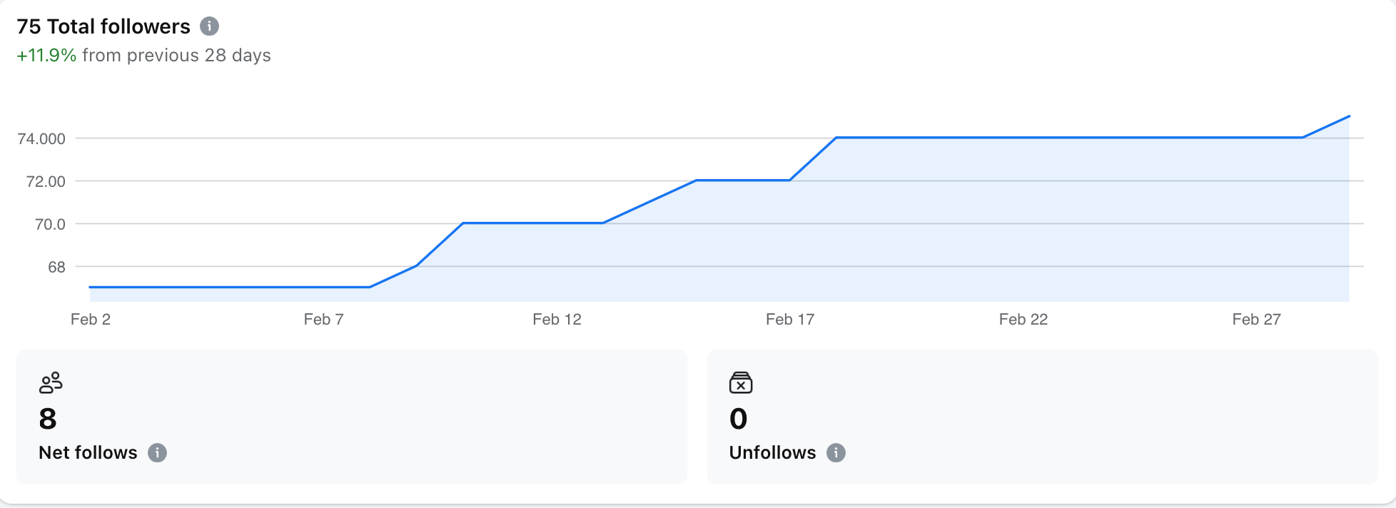
Website and Publication Report
Updated the website with recent information & events
March newsletter now available
LAA Facebook page continues to grow
  75 followers as of 3/2/2026
  12% increase over the past 28 days
  Continued growth, but at a slower rate

Slide 8
IT Committee Report
Transition to MS Business Basic (Free), initiated on January 24, still has no noticeable consequences to users
Board (group) mailing list address
  Several Board (but not all) members asked for a group mailing list address to contact board members at either their LAA @larc or personal email addresses with a single email address
  A group “@larc” address was setup up and works well
  Forwarding to board member home emails does not work

Slide 9
Old Business – Outstanding Actions
Further investigate the hybrid approach and investing with Vanguard and report back to the board. Unanimously approved by all present and on-line. (Ray Rhew – Jan 2026 Action)
  Initial contact made with Vanguard (preliminary options discussed)
  More details on AIAA investment approach provided (summary below)
    Established an Investment Portfolio
      maintain a minimum of 50% of its assets in high quality fixed income securities (includes investment grade corporate bonds, U.S. Treasury and government agency bonds, and mortgage-backed securities) and a minimum of 25% of its assets in common stocks of companies with expectations of above average growth and/or sustainable dividend payout.
      shall be realized through investment in high quality mutual fund(s) as opposed to a stock portfolio. The selected investment portfolio shall have an expense ratio less than 1% (less than 0.5% if possible).
      Eighty percent (80%) of all dividend and capital gain distributions for the fiscal year (Oct. 1-Sept. 30) preceding a scholarship award shall be applied toward a “Futures in Aerospace” scholarship(s).
      Twenty percent (20%) of all dividend and capital gain distributions each fiscal year shall be reinvested
Feb 2026 Update: Plan to continue discussions on Vanguard account opening and access procedures. Will hold action request until Ad Hoc committee objectives are completed.

Slide 10
Old Business – Outstanding Actions
LAA High-Yield Savings Account Investment : Charlie Dunton proposed placing $5000 in the high-yield savings account. Susan McClain seconded. Amended to Invest $15,000 in hi-yield savings account while Ray investigates future investing opportunities with Vanguard. Unanimously approved by all present and on-line (Ray Rhew – January 2026 Action)
Feb 2026 Update:
  After further investigation at LFCU – High-yield savings is not an option for business accounts
  Potential alternatives at LFCU Certificates of Deposit (CDs)
  New Proposal - $15K in a CD for 13 months
    $7,452.83 available (2026 projected expense - $1,275; 2027 HoH)
    Use time to investigate and finalize longer term investment strategy and execution plan (Ad Hoc committee results utilized)
    Early withdraw penalty: 6 months of interest on amount withdrawn
March 2026 Update – Closed Action: Motion approved in February meeting to invest $15k in CD at Langley Federal Credit Union.

Slide 11
Old Business – Outstanding Action
  President/Treasurer to discuss forming Ad Hoc Committee for Donations: Recommend process for soliciting and evaluating donation opportunities (Ray Rhew – January 2026 Action).
  Motivation – LAA Bylaws Purpose:
  Assist the LaRC to maintain contact with Alumni to the mutual benefit of the LaRC and the Alumni.
  Encourage and facilitate Alumni involvement in activities benefiting students from elementary school through college to increase the students’ ability to succeed in all educational opportunities.
Develop a process for researching and selecting opportunities to donate LAA funds that align with our mission, including the following Guidelines:
  for funds needed by the LAA for non-discretionary and discretionary categories to enable determining funds available for donations
  for acquiring funds other than membership dues
  for determining donation fund level
Feb 2026, Update: Ad Hoc Committee established in January; Ray Rhew – Committee Chair. Requested volunteers at Feb General Membership Meeting
March 2026 Update – Committee members met to discuss options

Slide 12
Old Business – Outstanding Actions
Retirement Protocol Question (Rich Antcliff) – What is the protocol policy that NASA follows for retirements (album, certificates, party)? Should the LAA have one?
  Nov 2024 & April 2025 Updates: Contacted NASA Langley Human Capital Ofc – The employee’s organization decides.
Jan 13, 2026: Action for President to determine approach for DRP Retirement Party: Possibly ad-hoc committee or Program Committee to lead.
Feb 2026 Update: Ad Hoc Committee, Retirement Protocols (NASA/LAA), was established.
  Rich Antcliff is the Committee Chair. Expanding scope to include short and long term activities. Committee Members: Rich Antcliff, Jill Marlowe, Sharon Monica Jones, and Christina Moats-Xavier
March 2026 Update: Retirement Celebration – May 1st @ 3:00 pm Reid
  Finalized initial plans with Steve Gayle (Office of the Director).
  Invite will go to employees who retired January 1, 2025 – January 31, 2026.
    Celebration Activities- Employee recognition, Class of 2025 photo, & light refreshments
  LAA members and Center employees will also be invited.

Slide 13
New Business

