Slide 1

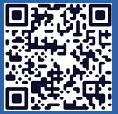
Langley Alumni Association (LAA) General Membership Meeting
Tuesday, May 12, 2026
2025 LAA Officers
President: Kathy Ferrare (757 880-8676)
Vice-President and Programs: Susan McClain (757 285-3778)
Secretary: Jill Marlowe (757 209-2131)
Treasurer: Ray Rhew (757 880-5817)
Communications Officer: Richard Hueschen (757 868-6453)
2025 Committee Chairs and Other Officials
Membership Committee: Amy Radford
Nominating Committee: Susan McClain
Hall of Honor Committee: Mary Beth Wusk
Website and Newsletter Committee: Rick Ross
IT Committee: Roman Paryz
Langley Representative: Eileen Nelson and Mariya Georgieva
Past President: Dan Palumbo
Registered Agent: Geoff Tennille
Larcalumni.org
Board Members-at-Large By Class
2027 2028 2029
Rich Antcliff Mark Ballin Mike Fremaux
Mary DiJoseph Charlie Dunton Wes Goodman
Susan McClain Odilyn Luck Jill Marlowe
Craig Ohlhorst Roman Paryz Neil O’Connor
Tony Pototzky Liliana Richwine Amy Radford
Ray Rhew Eric Rissling Ray Whipple
Geoffrey Tennille Dave Young

Slide 2
LAA General Membership Meeting – May 12, 2026
11:30 PM to 1:00 PM
  Welcome & President’s Report: Kathy Ferrare
  Secretary’s Report: Jill Marlowe
  Treasurer’s Report / Ad Hoc Committee – Donation Guidelines/Process: Ray Rhew
  Communication Report: Dick Hueschen
Committee Reports:
  Membership: Amy Radford
  Website and Newsletter: Rick Ross
  Information Technology: Roman Paryz (pass)
  Ad Hoc Committee – Retirement Protocols (NASA/LAA): Kathy Ferrare
  Hall of Honor: Mary Beth Wusk
Vice President’s Report: Susan McClain
Speaker: Lori Ozoroski presenting a Quesst Project Update: X-59 Soars: A New Era in Supersonic Flight Begins
Next Meeting (June 9, 2026): Dr. Kevin Marlowe – Large Language Models
Adjourn: Board Meeting next – All LAA members are welcome!

Slide 3
President’s Report – Kathy to update
LAA Health: Growth in Membership this month +6; Treasury is $23k
April 14, 2026, Board Meeting:
  DISCUSSION that LARC is not accepting STEM engagement volunteer opportunities due to lack of staff. ACTION for Susan McClain to contact LARC lead to find out how LAA can support STEM volunteer opportunities.
  MOTION PASSED by unanimous vote to spend $400 on Class of 2025 Retirement Celebration.
Exploring more targeted use of LAA social media to amplify LARC impact; Jill Marlowe, Rick Ross, and Amy Radford are discussing ways to strategically use LAA socials to amplify LARC contributions & spawn opportunities.
  If you are interested in helping write social media content, please contact Rick Ross (Website & Publication Committee Chair)
Please consider providing Rick Ross a write-up for our newsletter!

Slide 4
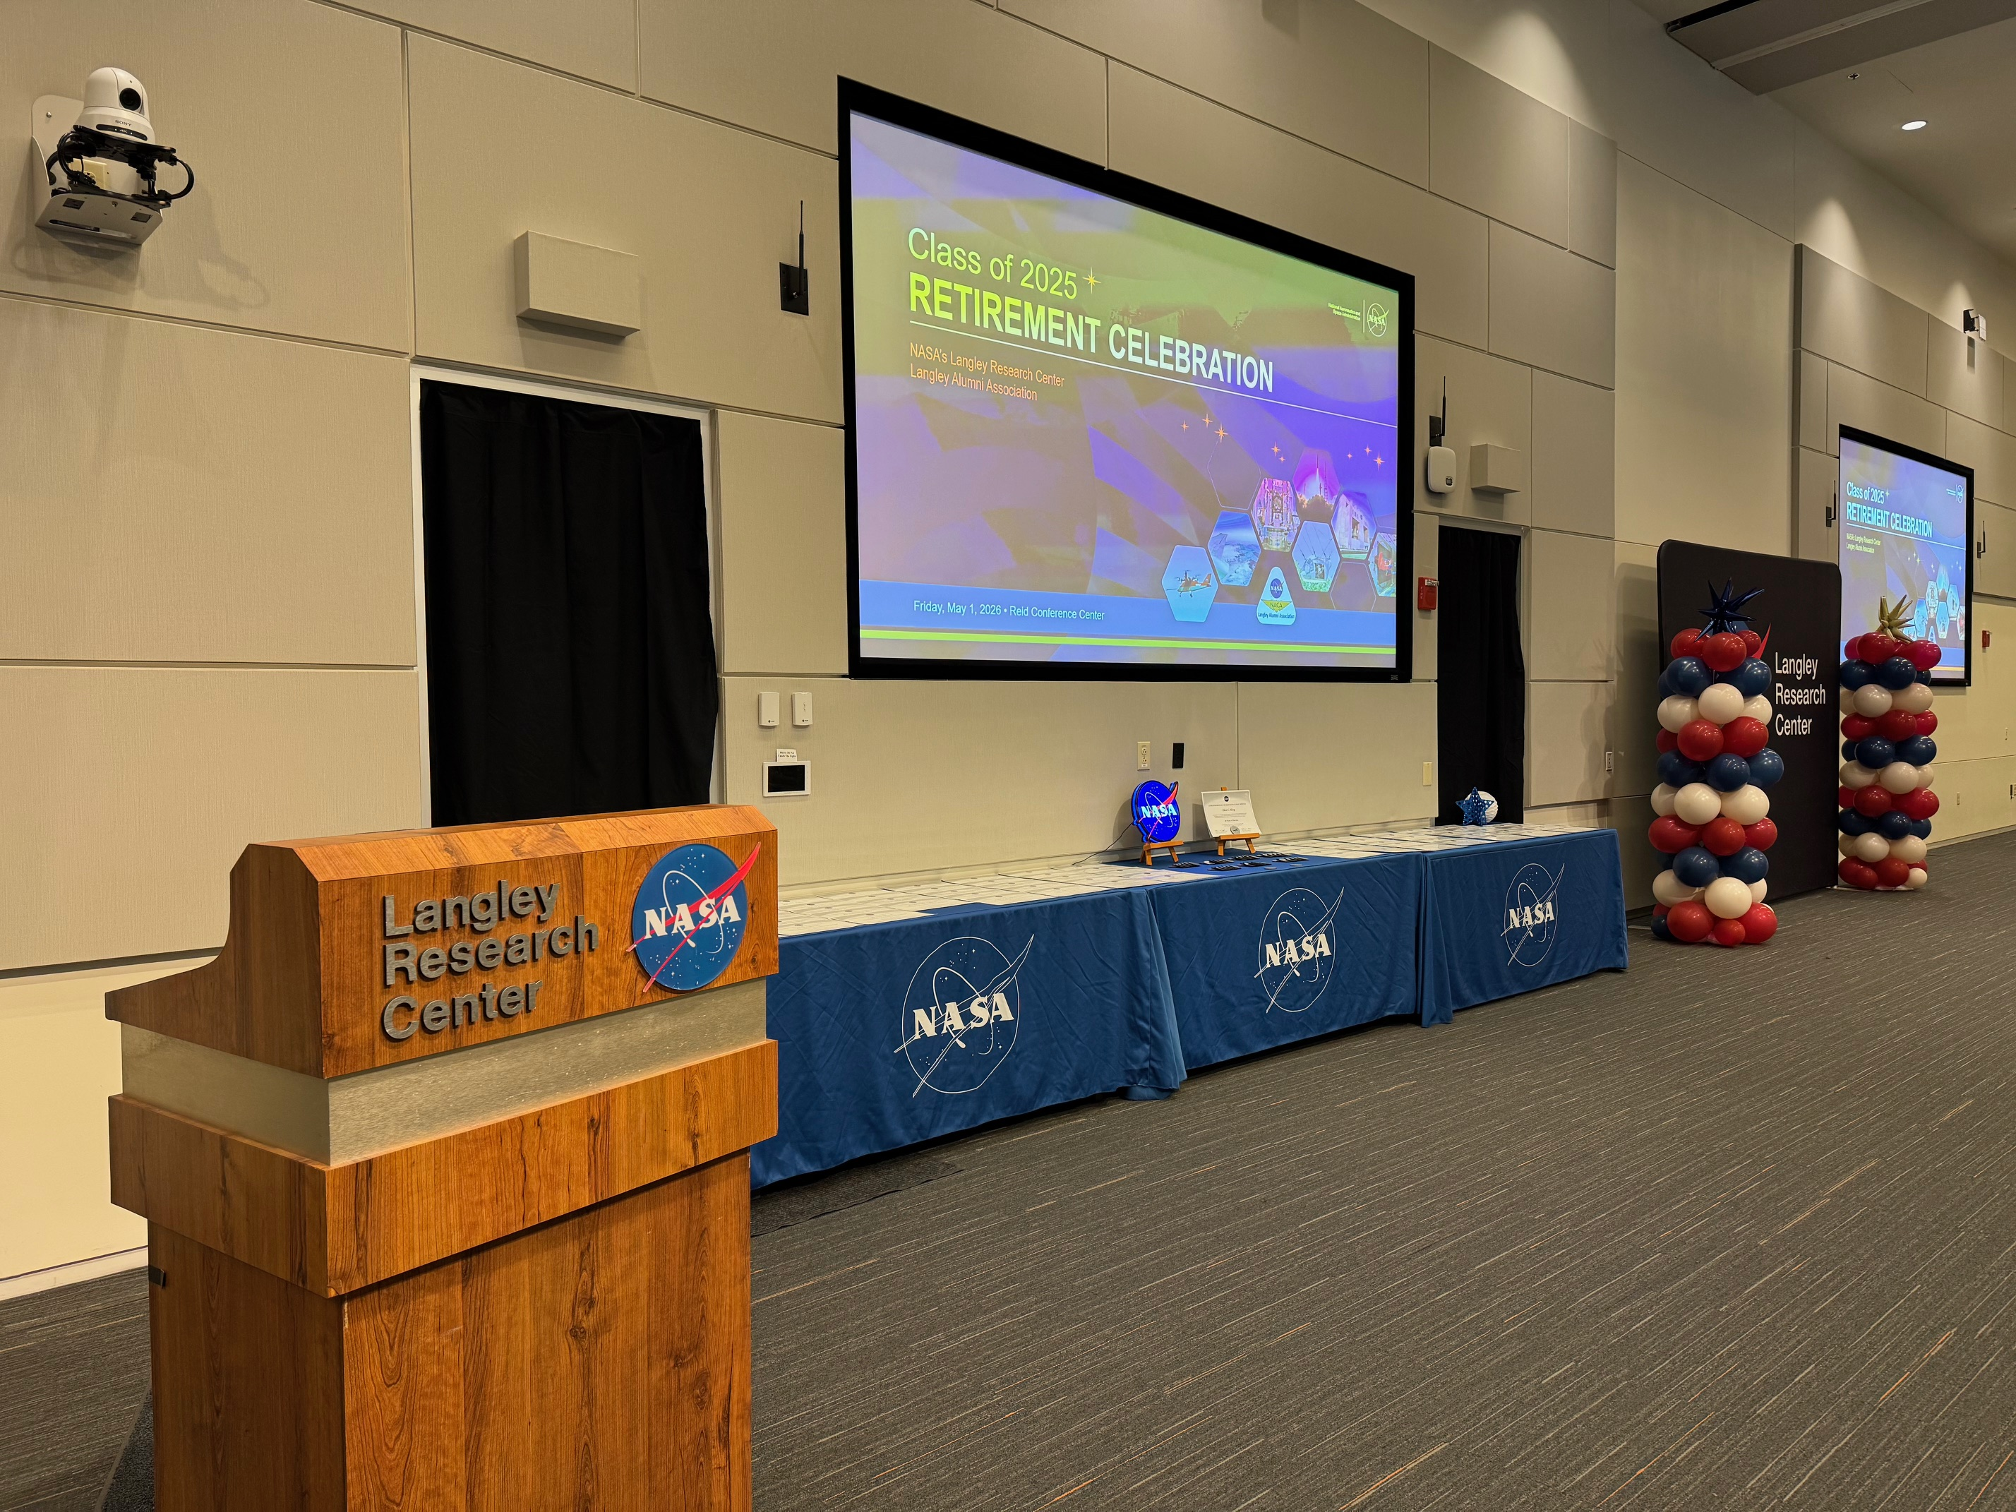
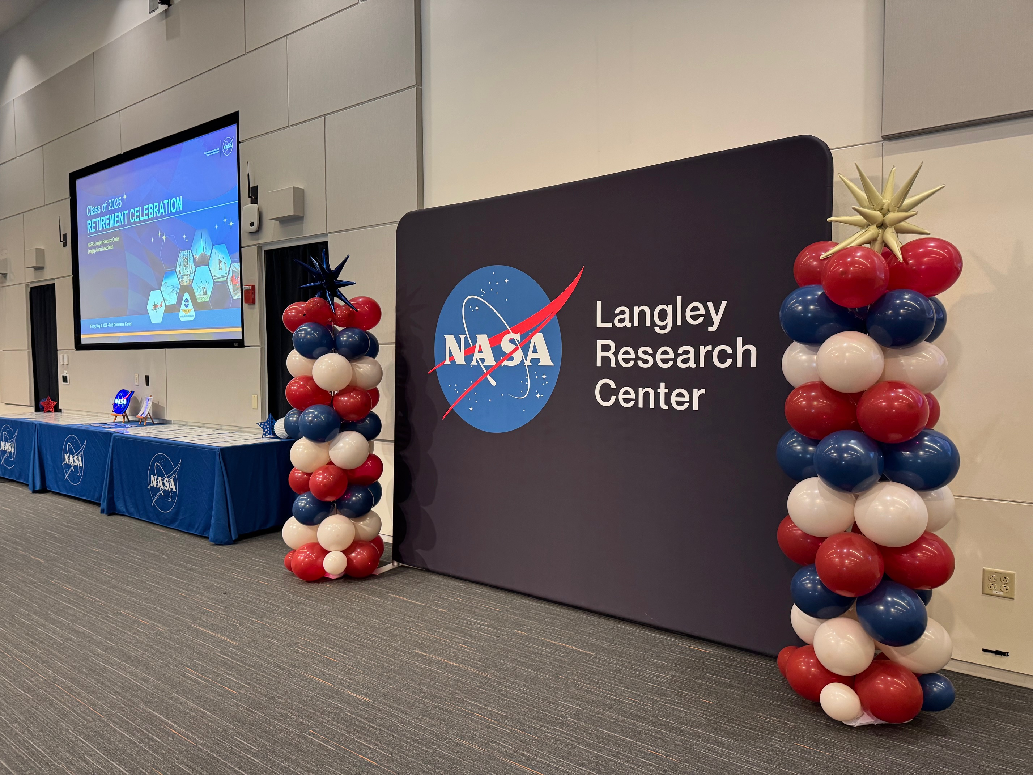
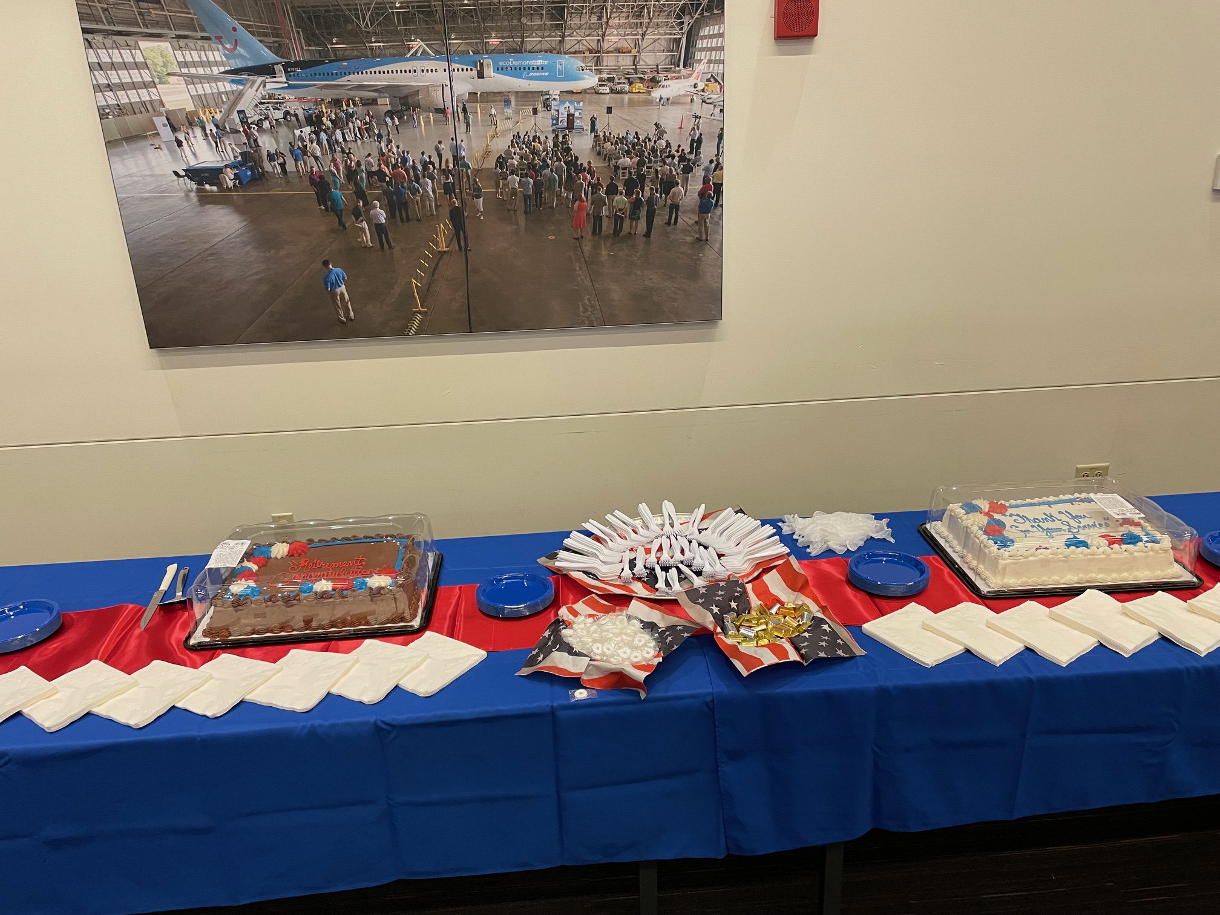
President’s Report
Class of 2025 Retirement Celebration
Successful Event with over 200 people in attendance!
Thank you to all our volunteers!
Jill Marlowe, Rick Ross, Maria Georgieva, Eileen Nelson, Rich Antcliff, Christina Xavier-Moats, Sharon Monica Jones, Lil Richwine, Amy Radford, Susan McClain, Odilyn Luck, Dave Young, Doug Arbuckle, Dick Hueschen, Mike Cisewski, Elizabeth Quinto, Frank Quinto, Charlie Dunton, Ray Rhew, Mary DiJoseph, Dave Hinton, William Hodges and Lucia Lee

Slide 5
Secretary’s Report
April 2026 General Meeting minutes approved & posted to Box
  ATTENDANCE: 64 in person, 16 on line
  No significant motions / actions / discussions
April 2026 Board Meeting Minutes approved & posted to Box
PLEASE SIGN THE ATTENDANCE SHEET BEFORE YOU LEAVE!

Slide 6
Treasurer Summary for April 2026
April 2026 Summary
  Organization Share $25.00
  Money Market Savings $4,460.10
  Smart Checking $3,728.86
  Certificate of Deposit $15,077.57
  Total $23,291.53
  Increase (from March): $550.35
    Income:
      Interest
      Dues (1 yearly, 4 lifetime)
      Donation for retirement ceremony
    Expenses
      None in April
  Submitted SCC annual report with updated officers and business contact
  Met with Yvonne Dellapenta and LAA CY2025 audit is complete with no material findings. Thank You Yvonne.

Slide 7
Ad Hoc Committee: Donation Guidelines/Process
Develop a process for researching and selecting opportunities to donate LAA funds that align with our mission, including the following Guidelines:
for funds needed by the LAA for non-discretionary and discretionary categories to enable determining funds available for donations
for acquiring funds other than membership dues
for determining donation fund level
Update
Team – Rick Ross, Bill Tomek, Dave Young
Met with Melvin Ferebee – Virginia Air and Space Center
  Provided and discussed several ideas for donation opportunities
Developed summary charts on findings and recommendations to be presented to the LAA Board

Slide 8
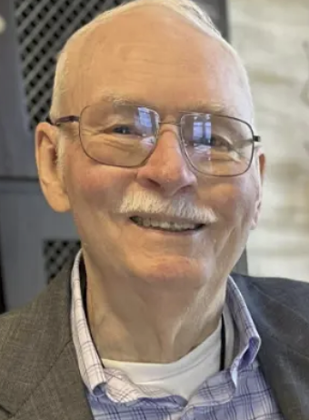
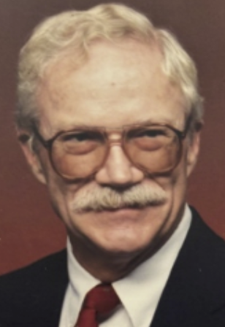
In Memory Of Individuals May 12, 2026
John Lamar, 86
Charles (Chuck) Eldred, 86

Slide 9
Membership Report
6 New members:
Edward Generazio retired from the Research Directorate in 2018 with 35 years service. Edward resides in Yorktown with his spouse Susan.
Michelle Ferebee retired from the Strategic Partnerships Office in 2025 with 42 years service. Michelle resides in Hampton with her spouse Melvin.
Michelle Munk retired from the Space Technology and Exploration Directorate and Space Technology Mission Directorate in 2026 with 38 years service. Michelle resides in Chesapeake with her spouse Christopher.
William (Bill) Cann retired from the Office of Procurement in 2025 with 15 years service. Bill resides in Virginia Beach with his spouse Deborah.
Scott Hill retired from the Engineering Directorate in 2026 with 31 years service. Scott resides in Georgia with his spouse Marjorie.
Bart Singer retired from the Office of Director in 2025 with 38 years service. Bart resides in Williamsburg with his spouse Chandi.

Slide 10

Membership Report
Currently, we have 296 Active Members
Membership Committee Initiative Updates
    Application Process
        Met with Data Analytics Analyst on March 10 and April 14
        Developed, tested, collected feedback, and refined new LAA application form
        Next steps –
          Update LAA website with new application process instructions and form – then roll out new form in May
          Migrate data from current roster
          Start development of modules and workflows – Roster and Badge Requests
Be sure to sign the attendance sheet!

Slide 11
Website & Publications
Finalized the booklet for the Class of 2025 Retirement Celebration
Updated the website with recent information & events
LAA Facebook page continues to grow
Thanks to all who submitted newsletter articles
for our June 2026 newsletter!
If you are planning on submitting an article but have not yet done so, please submit as soon as possible!

Slide 12
Ad Hoc Committee: Retirement Protocols (NASA/LAA)
Outstanding Action from LAA Board Meeting: Retirement Protocol Question (Rich Antcliff) – What is the protocol policy that NASA follows for retirements (album, certificates, party)? Should the LAA have one?
April 2026 Update: Retirement Celebration – May 1st @ 3:00 pm
  75 RSVP’s received inviting 90 guests / Estimated attendance 300 people
  Completed and in graphics/printing: Celebration program, certificates, retiree gift
  Announcement to Center personnel placed on Inside Langley. Flyer also to be sent to Langley organizations.
  Announcement to LAA members, request for one-day badges for LAA members (not retirees/guests to be celebrated), and request for volunteers
    RSVP for a one-day badge and/or plan on volunteering due Sat, 4/19
May 1st Retirement Celebration was a HUGE Success!
  Received several Thank You notes from the retirees.
  Thank you so much to everyone that participated in making this event so wonderful!
  Approved Budget: $400 / Initial Expenses: $370 (awaiting 1 more expense invoice)

Slide 13

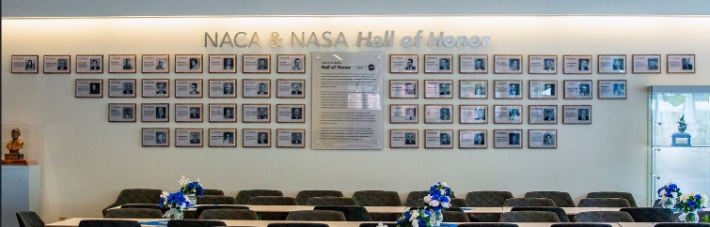
NASA Langley Leadership and
Langley Alumni Association (LAA) Hall of Honor Meeting
Hall of Honor (HoH) Overview
  History
  Nomination Criteria
  Nomination Process and Timeline
NASA Langley and LAA Responsibilities
Next Steps

Slide 14
Hall of Honor History
Memorandum of Understanding (MOU) Objective
LAA and Langley to work together in
further developing and sustaining the
Langley Research Center NACA and NASA Hall of Honor.
Three (3) Honoree classes have been inducted – Total of 54 Honorees
  Class of 2015 – 19 Inductees
  Class of 2017 – 18 Inductees
  Class of 2022 – 17 Inductees
Continue five (5) year cadence moving forward.

Slide 15
Class of 2022 Award Criteria
A minimum of ten (10) years’ work for NACA and/or NASA at the Langley Research Center. Civil servants and on/near site contractor nominees shall be eligible.
The nominee must be fully retired and no longer directly engaged with Langley as a contractor or consultant.
The nominees shall have made sustained contributions to and had far-reaching influence on the leadership, direction, mission, and capabilities of the NACA Langley Memorial Aeronautical Laboratory, the NASA Langley Aeronautical Laboratory, and the NASA Langley Research Center.
The nominee must have made unprecedented and fundamental contributions to the advancement of either a technical and/or science field or mission support expertise, with significant impacts to the United States aerospace community for commercial or military aircraft, spacecraft, or atmospheric sciences.
Note: Class of 2022 Final Report included several recommendations referring to the award criteria. The Class of 2027 Selection Committee, along with the Hall of Honor Chair (Mary Beth Wusk) and NASA Langley Senior Liaison (TBD), will review the criteria and adjustments would be made prior to the nomination form is released.
Under Review

Slide 16
Class of 2022 Nominee Write-Ups
An overview of the candidate’s notable contributions with enduring impacts to the field of aerospace sciences.
The impact of the achievements and how they benefited NACA/NASA and the aerospace community.
Appropriate additional relevant information, e.g., the nominee’s dates and places of work, professional affiliations and awards, degrees held, etc.
Any other information relevant to the nominee’s qualifications.
Data Collection: On-line form only / Nomination Basis response up to 4,000 characters (~600 words)
Note: Class of 2022 Final Report included several recommendations referring to the award criteria. The Class of 2027 Selection Committee, along with the Hall of Honor Chair (Mary Beth Wusk) and NASA Langley Senior Liaison (TBD), will review the criteria and adjustments would be made prior to the nomination form is released.
Under Review

Slide 17
Proposed Class of 2027 Schedule

Slide 18
HoH Committee Org Structure/Responsibilities
LAA HOH Committee Chair – Mary Beth Wusk
HOH Operations Team
Mary Beth Wusk (Chair)
NASA Langley – At least 2 Representatives (1 Senior Liaison; 1 Center Representative (assist HoH coordination))
LAA – At least 3 Representatives
Hampton Roads Partners - 1-2 Representatives
Honorees Selection Committee
NASA Office of the Director selects Senior Committee Lead
NASA – 2 Representatives
NASA Langley History & Archives Program manager or designee
LAA – At least 2 Representatives
Hampton Roads Partners – 2 Representatives, including retirees with NASA Langley knowledge and its history
High Level Responsibilities:
Establish Ops Team/assign Roles & Responsibilities
Update Operating Guidelines
Update automated nomination process (as needed)
Marketing/Promotion
Event planning (pre-planning, day of, post-event)
Final Report Document (includes Lessons Learned)
Langley support on an as-needed basis:
Conference Support, graphics, printing, communication (inside/outside Langley), protocol, public affairs
Team member selection to include:
diverse career experiences
Responsibilities:
Review nomination selection criteria and prior class recommendations
Receive/evaluate nominations
Make recommendations to the Hall of Honor Operations Committee
Report status throughout process

Slide 19
Class of 2022 Expenses & 2027 Estimate
Hall of Honor Induction Ceremony and Reception
NASA Langley Research Center | Class of 2022 Cost | Class of 2027 Estimated Cost
NACA Room Wall Tiles (2022 Keith Fabry Contract) | $3,590 | $4,000
NASA meatball photo op backdrop (Zilla Contract) | $1,002
TOTAL NASA Langley | $4,592 | $4,000
NASA Langley Alumni Association
NASA Langley Exchange Refreshments | $464 | $1,000
Appreciation Gift (Program Writer) | $100 | $100
Framed Artwork Materials (2022 Hampton Roads Wholesalers) | $654 | $4,500
TOTAL LAA | $1,218 | $5,600
GRAND TOTAL | $5,810 | $9,600

Slide 20
LaRC/LAA Hall of Honor Committee Update/Next Steps
Apr 8th: Met with LaRC Center Director
Apr 14th: Kick-off meeting with HoH Operations Committee
May 12th: HoH Ops Team Meeting
  Discuss Marketing/Promotion
  Establish Ops Team/assign Roles & Responsibilities
May TBD: Meet with Selection Committee
Sept 1st: Electronic Nomination Form Activated on LAA Website

Slide 21
Back Up Charts

Slide 22
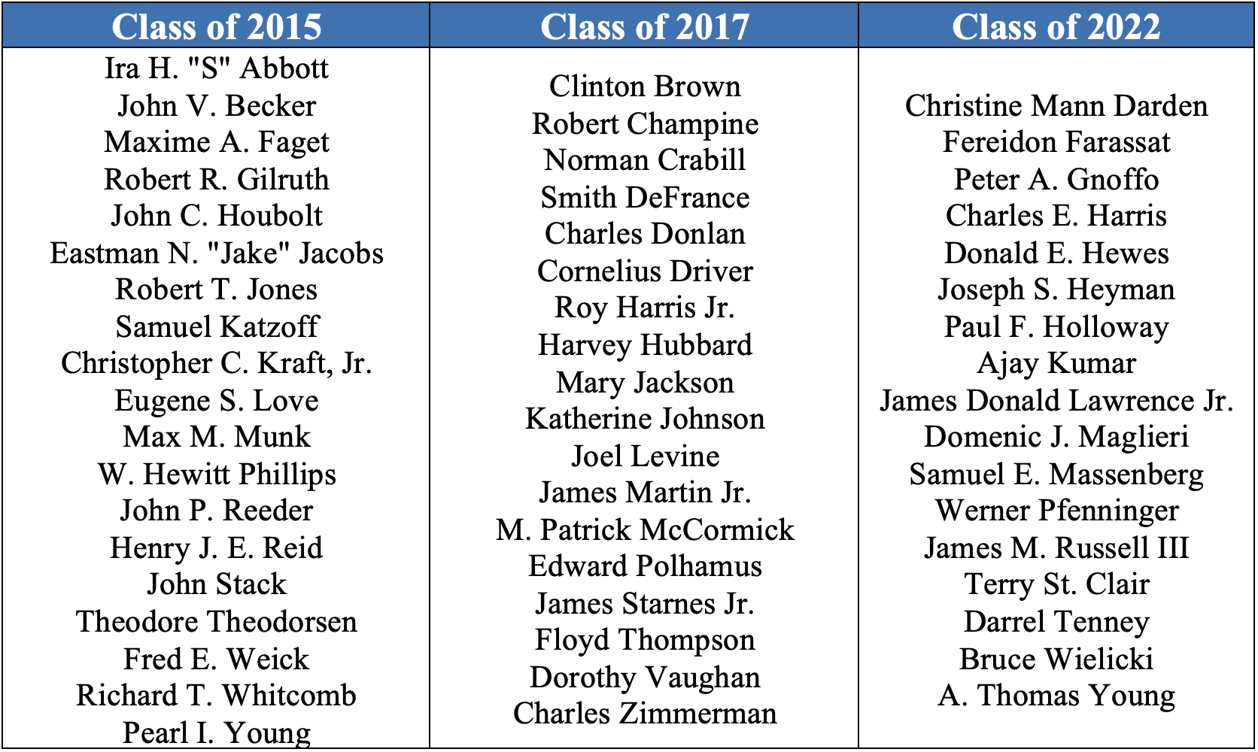
NACA & NASA LaRC Hall of Honor Classes
54 Members

Slide 23
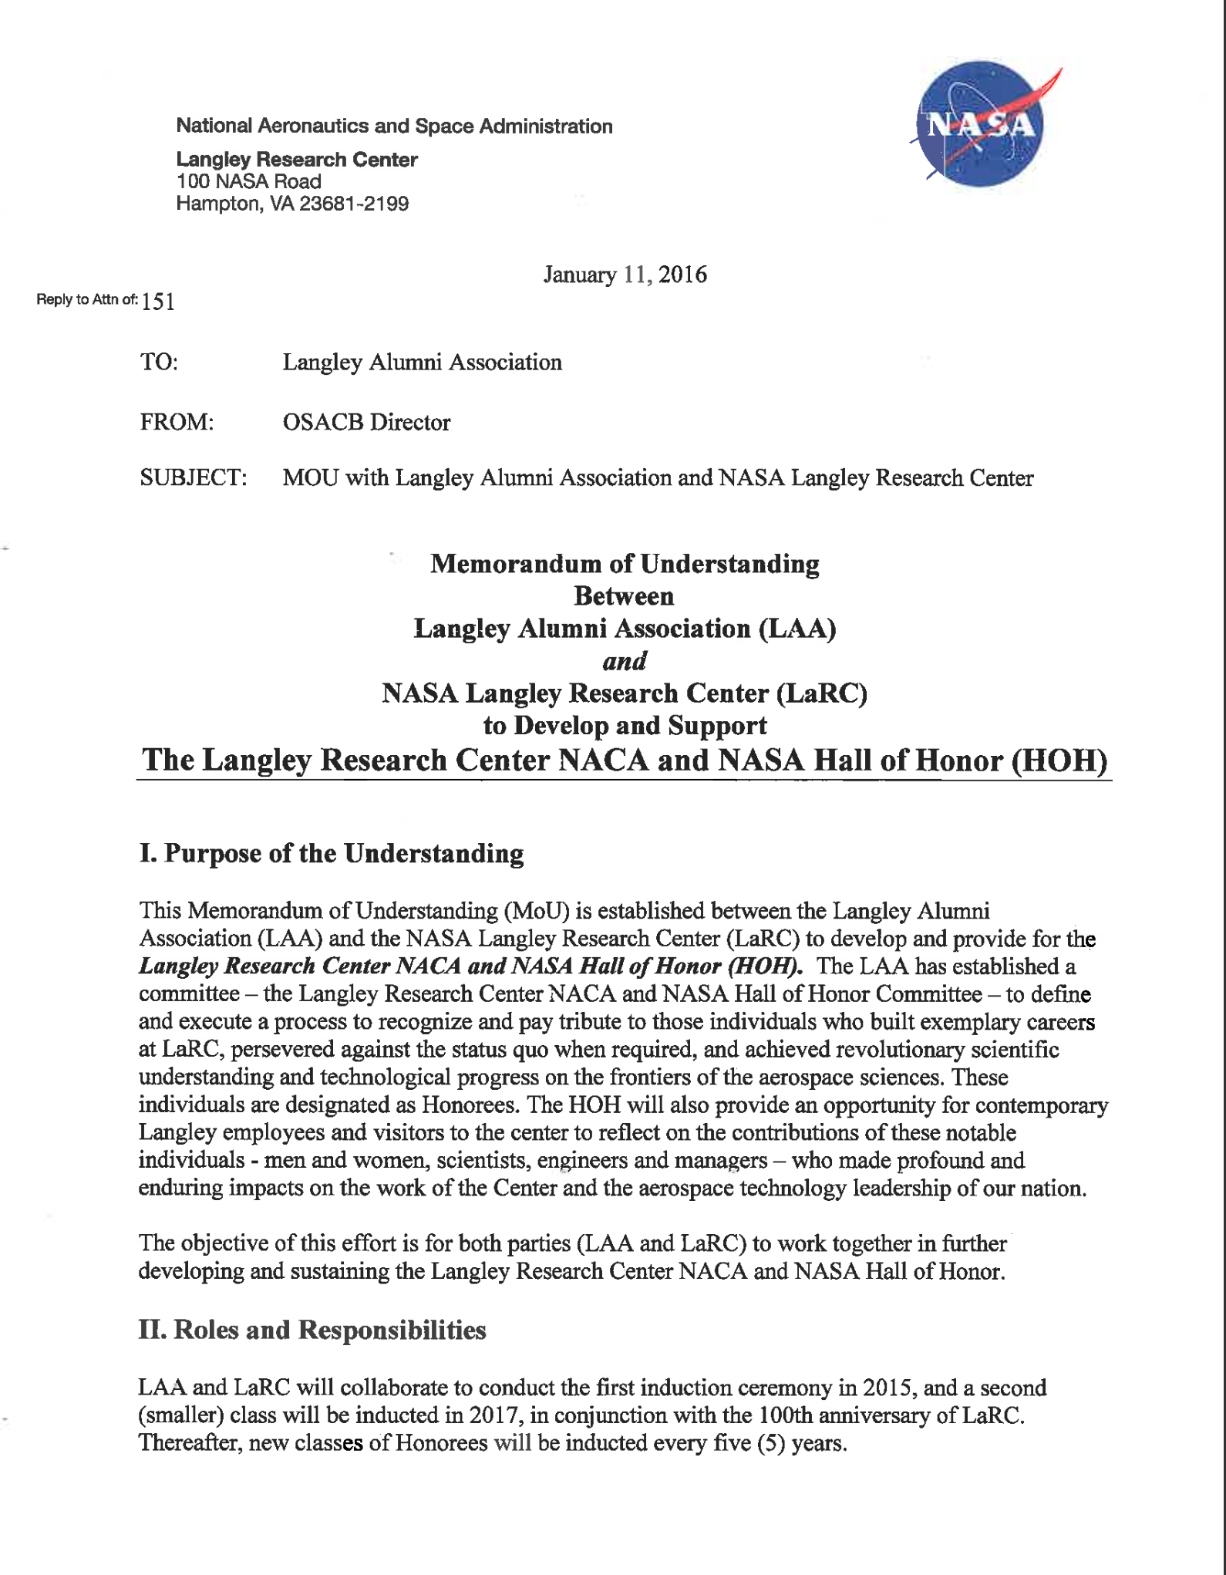
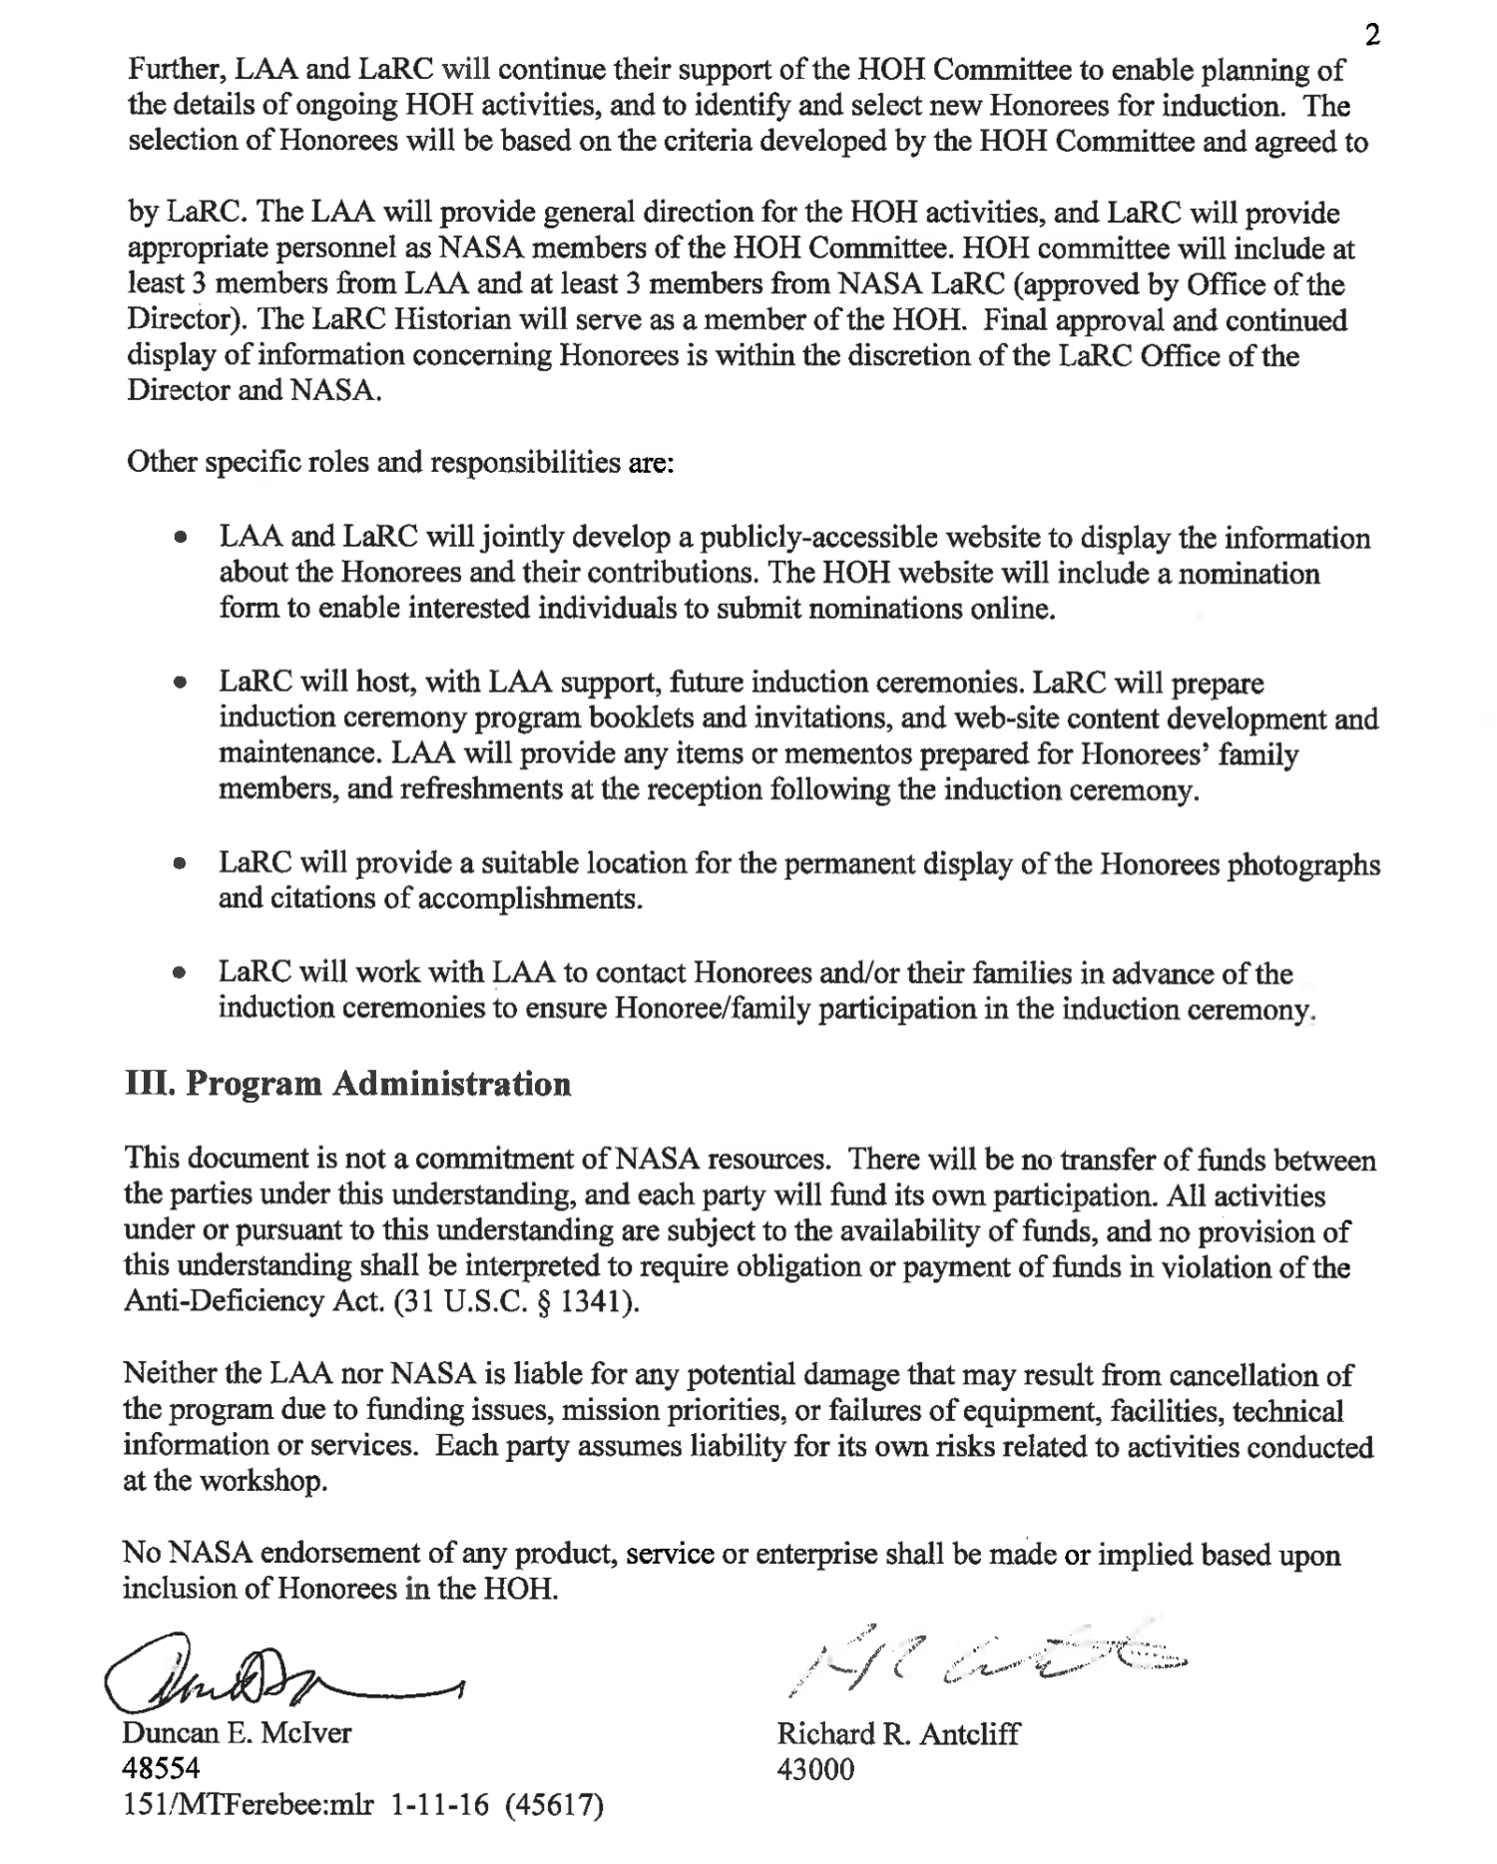

Slide 24
Vice President Report – Membership Involvement
Langley Anniversary Orchestra (July 16, 2026)
As part of NASA Langley’s celebration of the 250th Anniversary, they want to showcase the incredible musical talent within our center.
They are planning to assemble a special Langley Anniversary Orchestra and are inviting interested musicians to participate.
Dates:
  July 15th 4:00-7:00 pm Reid – Dress Rehearsal
  July 16th 3:00 pm – Call Time
  July 16th 5:30 pm Reid - Show Time
The LAA will be sending out a request for members to sign up. If you’d like to help organize this, please see Susan.

Slide 25
Vice President Report – Membership Involvement
Potential Volunteer Activity: Virginia Earth Systems Science Scholars (VESSS) and Virginia Aerospace Science and Technology Scholars (VASTS) Programs volunteer opportunities.
  Awaiting a response from Chris Carter
  Will send out information once received.
  In the past:
  Seeking mentors to help students design a hypothetical human mission to the Moon and on to Mars
  Location: Langley Research Center on-site
  Timeframe:
    Multiple one-week sessions throughout the June – July timeframe
    Mentors needed throughout the week (can sign up for an hour or more)

Slide 26
Vice President Report – Upcoming Speakers
May 12, 2026 –Quesst Project Update: X-59 Soars: A New Era in Supersonic Flight Begins presentation by Lori Ozoroski, NASA Langley
June 9, 2026 – Dr. Kevin Marlowe, Using AI to power your retirement
July 14, 2026 – LAA Picnic in the cafeteria (B2102)
August 11, 2026 – Stephanie Letourneau, Wetlands Watch
September 8, 2026 – Allen Kilgore, Deputy Center Director, Update to the State of the Center

Slide 27
Vice President Report – Upcoming Speakers
October 14, 2026 – Bryan Barmore, Master Naturalist Program
November 10, 2026 – Neil O’Connor, NASA Langley’s Air Traffic Operations Laboratory
December 9, 2026 – Holiday Luncheon
Potential Speakers:
Generation180
SCIFLI Update

Slide 28
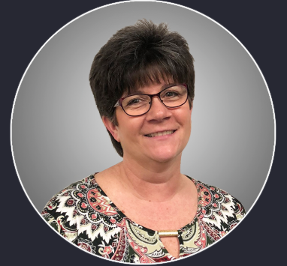
Today’s Speaker
Lori Ozoroski
Quesst Project Update
X-59 Soars: A New Era in Supersonic Flight Begins

